Slide 1
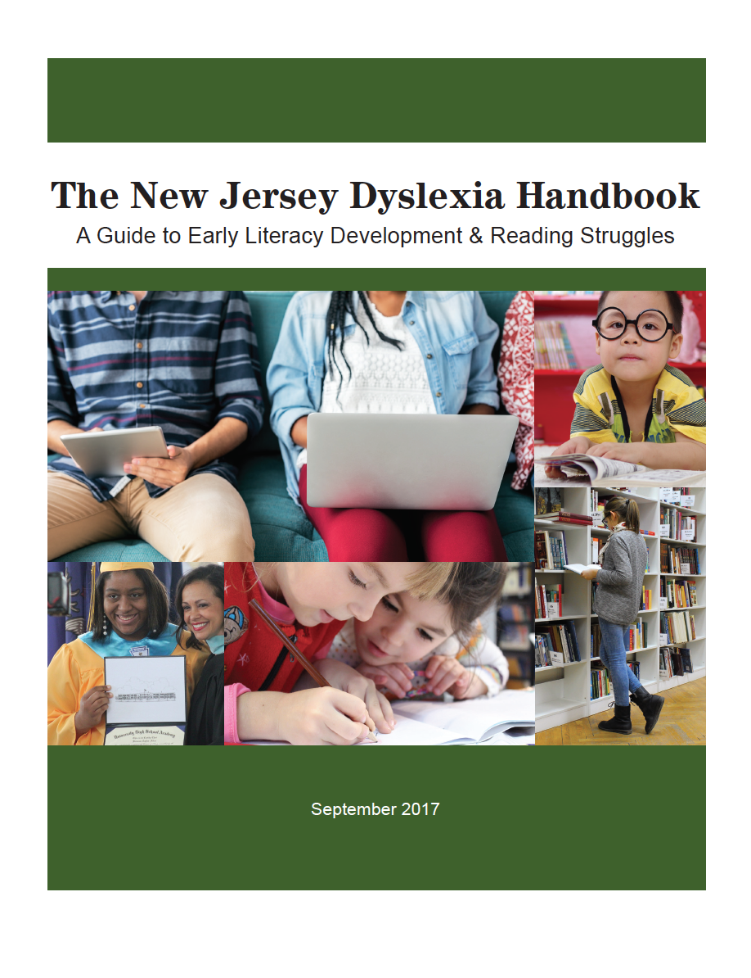
Exploring The New Jersey Dyslexia Handbook: A Guide to Early Literacy Development & Reading Struggles
Session 4
Notes:
Welcome to session 4 of the webinar series “Exploring the New Jersey Dyslexia Handbook: A Guide to Early Literacy Development and Reading Struggles.” This four part webinar series is designed to help school districts become familiar with the guidance contained in the state handbook and to support district-based stakeholder teams in making the best educational programming decisions for the students in their schools. This series can be used as an implementation tool for districts interested in building a strong preventive model of screening and tiered intervention for students struggling in the area of reading. Each installment will provide team members with an overview of content and activities to support the team members in translating the information discussed into best practices in their schools and classrooms.
In this fourth and final installment of the series, we will review the diagnostic and comprehensive assessment section of the handbook.

Slide 2
Assessment Leads to Sound Instructional Decision-Making
Screening/Benchmarking
Decisions
Progress-Monitoring
Decisions
Diagnostic Decisions
Summative/Outcome Decisions
Notes:
Assessment serves a range of functions within the public school setting. Students are exposed to different types of assessments: screening or ongoing benchmark assessment, progress monitoring, diagnostic, and summative or outcome assessments. Each of these serves a different purpose and data from each of these assessments should guide instructional decision making.

Slide 3
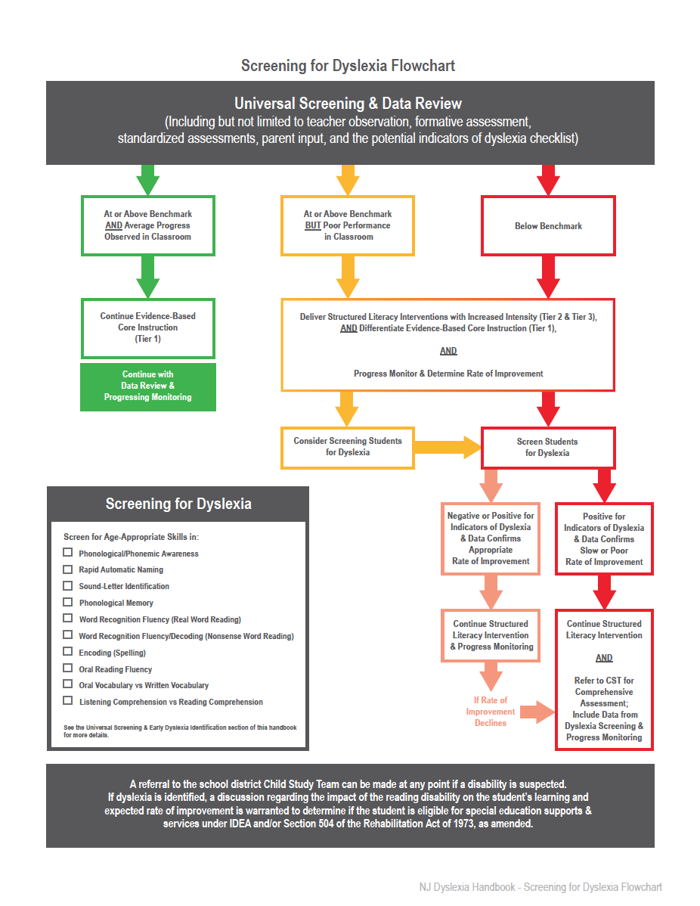
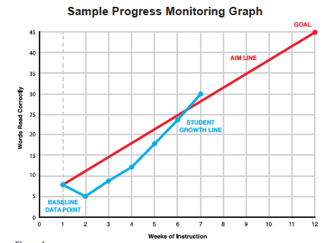
Screening and Progress Monitoring Decisions
Notes:
As discussed in session 2 of this webinar series, the best practices outlined in the screening for dyslexia flowchart illustrates the administration of universal screening measures at least 3x a year for ALL students. These screening and benchmarking assessments help determine who is performing adequately and who is at risk for future reading failure. Those students identified by the district’s universal screening tools as “at-risk” should be promptly placed into structured literacy interventions and progress monitored for their response to the intervention provided.

Slide 4
Diagnostic/Comprehensive Assessment to Drive Instruction
Function: To develop an instructional plan in response to a student’s individual strengths and weaknesses
Question: What and how should we teach this student?
Data Collection By: Classroom teacher, Reading Specialist, I &RS Case Coordinator, Intervention Specialist, NJTSS team member
Evaluation Procedure: A personalized evaluation procedure that will allow the careful and systematic examination of a student’s skills utilizing data from nationally-normed universal screening tools, progress monitoring tools, informal curriculum-based assessments, and formal standardized assessments
Notes:
Now we will turn our attention to diagnostic/comprehensive assessment. This type of assessment provides information about a student’s strengths and weaknesses so that an appropriate instructional plan can be developed. It answers the important questions: “What should we teach and how should we teach this student?”
These assessments are completed collaboratively by all who work with the student including the classroom teacher, reading specialist, I&RS Case Coordinator, Intervention Specialist, and NJTSS team members. Multidisciplinary team members should have a strong base of knowledge about all aspects of reading acquisition and multiple measures from all prior assessments and other data can be used.
Several areas of language and literacy can be explored during this diagnostic/comprehensive assessment using “nationally-normed universal screening tools, progress monitoring tools, informal curriculum-based assessments and formal standardized assessments.”

Slide 5
Oral Language Skills
Potential Indicators of Dyslexia
Classroom Observations:
sentence length in oral communication
vocabulary words in verbal expression compared to written expression
Picture Vocabulary Measure
Oral Vocabulary Measure of Synonyms and Antonyms
Listening Comprehension Skills
Stronger higher-level language skills than low-level language skills, particularly phonological processing
Oral language skills superior to written language skills
Possible word retrieval deficits
Notes:
Oral Language Skills: Oral language refers to the ability to listen to and understand speech as well as to express thoughts through speech. It consists of low-level skills, such as recognizing and producing speech sounds, and higher-level skills, such as understanding meaning by listening to someone speak or expressing thoughts in sentences.
Some information about a student’s oral language skills can be collected through classroom observation. For example, educators can note the sentence length used by the student in oral communication and if possible record an oral language sample to be transcribed later. The student’s average sentence length can be compared to typical language milestones, such as a typical 5 year old uses 5 word sentences, a typical 6 year old uses 6 word sentences and so on. Also educators should note the vocabulary words a student uses in verbal expression and compare those to the words used in written samples. Is the use of word sophistication and sentence length the same when comparing oral vocabulary and written vocabulary? Is one modality higher than the other? This is important information regarding the student’s language skills in both oral and written formats.
Some nationally normed screeners include measures of picture vocabulary that ask students to name an object depicted in an illustration as an indication of a child’s oral expression skills.
And, some informal and standardized assessments include subtests that measure a student’s knowledge of synonyms and antonyms. Some provide students a target word and ask them to produce a synonym or antonym and others ask students to select a response from a list of synonyms and antonyms.
Also, some informal reading inventories include passages that can be read to students to assess their listening comprehension skills. After listening to a passage, students can be asked to retell, summarize or answer questions to demonstrate their understanding of the passage just read to them.
When considering oral language data, educators should be aware that students with dyslexia often have strong higher-level language skills. They characteristically have problems or a deficit in low-level language skills, particularly phonological processing. This deficit in phonological processing limits the ability to learn to read and spell using the sounds of language.
Typically, if a student has average level oral language skills but has much difficulty developing written language (reading and spelling) skills, this is an indicator of dyslexia.
Some individuals with dyslexia may have word retrieval problems and/or difficulty remembering, recalling or pronouncing sound combinations.

Slide 6
Phonological Awareness
Potential Indicators of Dyslexia
Screening: Phoneme Segmentation
Informal Assessment:
Word Discrimination
Rhyme Recognition
Rhyme Production
Syllable Blending
Syllable Segmentation
Syllable Deletion
Phoneme Recognition
Phoneme Blending
Phoneme Segmentation
Phoneme Deletion
Nonword Repetition Task
Phonological Awareness Weaknesses
Phonemic Awareness Weaknesses
Phonological Memory Weaknesses
Notes:
Phonological Awareness is a broad class of skills that include attending to, thinking about and intentionally manipulating phonological aspects of spoken language. This includes awareness of words, syllables, onset-rimes and individual phonemes. Working at the individual phoneme level is called phonemic awareness.
Typical screening assessments include measures of phoneme segmentation, however, students often struggle with other phonological and phonemic awareness tasks along the developmental continuum and may require instruction targeted to these areas. An informal assessment can be conducted to determine which skills on the continuum are secure and which are areas of weakness. Many informal assessments of phonological and phonemic awareness already exist that a teacher can use to assess a student’s skills.
A nonword repetition task can be administered to measure how well a student can represent a new and unfamiliar phonological sequence in memory. This type of task asks a student to repeat a word such as “ indentrope”. A district’s speech and language specialist may be able to help locate an informal nonword repetition task that a teacher may use to assess a student’s skills in this area.
Indicators of dyslexia include weaknesses in phonological awareness, phonemic awareness and/or phonological memory. Spelling and decoding difficulties result from these deficits in the phonological component of language.

Slide 7
Rapid Naming Skills
Potential Indicators of Dyslexia
Screening: RAN
Informal Assessment:
Colors
Letters
Objects
Numbers
Naming speed deficits
Both naming speed and phonological processing deficits are considered a “double deficit”
Notes:
Rapid naming skills refers to the ability to quickly access presumably rote information. Some universal screeners include a measure of rapid automatized naming.
If your district’s universal screener does not include a RAN measure, educators can create and administer informal rapid naming tasks to students by presenting a chart of known items such colors, letters, objects, and numbers in random order and asking students to name the items as quickly as they can. The time it takes to complete the task can be recorded and compared to the performance of other children in the classroom.
If educators create their own Rapid Naming Skills measure, remember that the results provide an informal measure of students’ skills since scores are not standardized to norms. This informal measure should be combined with other measures of students’ proficiency in reading.
Students with dyslexia often have slow speed in processing visual or auditory information which is measured using Naming Speed tasks, as well as other tests of more general processing speed available in frequently used standardized tests. Slow naming speed results in problems developing reading fluency. Deficits in Rapid Naming Skills are a red flag for further data collection.
Students with both a naming speed deficit and a phonological processing deficit are considered to have a “double deficit.”

Slide 8
Word Recognition & Decoding
Potential Indicators of Dyslexia
Screening: Letter-Sound Fluency, Nonsense Word Fluency, Oral Reading Fluency (Accuracy Rates)
Informal Phonics Surveys & Reading Inventories
Real Words
Nonsense Words
Irregular Word Lists
Difficulties with word attack skills and phoneme-grapheme (sound-letter) correspondences
Accuracy and/or fluency difficulties
Notes:
Word recognition, also called word reading or word identification, is the ability to read single printed words. Decoding is defined as the process of using letter-sound correspondences to sound out words or nonsense words.
Typical screening assessments include measures of Letter-Sound Fluency, Nonsense Word Fluency, Oral Reading Fluency Accuracy Rates. These tests of word recognition and decoding that score both accuracy and the time it takes for the student to read the words (known as automaticity or fluency) are particularly useful.
Phonics surveys that organize task items by syllable type and informal reading inventories that include grade-level word lists can also provide important instructional information. Some of these tools will assess students’ decoding accuracy and automaticity and many will include lists of nonsense words for students to read. Knowing what phonics skills students have mastered and what skills they have not yet mastered allows for targeted instruction.
Additionally, it is important to assess a student’s ability to read a list of phonetically irregular words. A comparison should be conducted to look at a student’s performance on reading phonetically regular words, decoding nonsense words, and reading phonetically irregular words.
Students with dyslexia have difficulty with these word attack skills particularly with learning to accurately apply phoneme-grapheme or sound-letter correspondences when decoding. While they may become accurate word readers following appropriate intervention, often they are still very slow when reading or decoding words.

Slide 9
Reading Fluency
Screening: Oral Reading Fluency (Accuracy and Automaticity Rates)
Informal Reading Inventories & Curriculum-Based Measurements
Automaticity
Accuracy
Measures of Prosody
Notes:
Reading fluency is defined, by Dr. Jan Hasbrouck, as reasonably accurate reading at an appropriate rate with suitable expression that leads to accurate and deep comprehension and motivation to read.
Typical screening assessments include measures of Oral Reading Fluency that calculate both accuracy and automaticity rates. Reading fluency can also be assessed using Informal Reading Inventories and Curriculum-Based Measurements that ask students to read aloud a passage for one minute while the instructor counts errors to determine the number of words read correctly per minute. This calculation provides information on a student’s reading rate (or automaticity) which can be compared to norms established by Hasbrouck and Tindal by grade level.
An accuracy rate is determined by dividing the number of words the student read correctly by the number of total words read and measures of prosody typically include a qualitative rating on a scale of 1 to 4 with a score of “1” indicating word by word reading and a score of “4 “indicating reading primarily in larger, meaningful phrase groups with interpretative expression. It is recommended to use more than 1 passage at a time to assess oral reading fluency. The median or mean scores of three passages is often recommended.
A student’s performance can be analyzed to determine if he or she is a fast and accurate reader, a fast but inaccurate reader, a fast and accurate reader who has difficulty with expression, a slow but accurate reader, or a slow and inaccurate reader. Depending on the profile of a student, instruction can be tailored to address specific student needs.
Students with dyslexia often exhibit inaccurate and slow oral reading. Inaccuracies can include mispronunciations of words, omissions of words, and substitutions of words and their reading rate is often poor and laborious.

Slide 10
Reading Comprehension
Potential Indicators of Dyslexia
Informal Reading Inventories
Retellings
Questions
Curriculum-Based Measurements
Cloze Tasks
Maze Tasks
Reading comprehension skills are lower than listening comprehension skills
Notes:
Reading comprehension is different from listening comprehension because it relies on the student’s ability to decode text. Measuring reading comprehension can be complicated as reading comprehension tests vary significantly in their processing demands and how they measure this complex ability. Some informal reading inventories ask students to retell a passage that they have read either orally or silently and some include specific questions that can focus on literal and inferential thinking. Sometimes the passage is available for students to look back at when answering questions and sometimes students are not allowed to look back at the passage. Some informal reading inventories provide additional passages to assess a student’s listening comprehension of a text read to them as a comparison measure to oral or silent reading tasks.
Curriculum-Based Measures may also provide information on reading comprehension such as cloze reading tasks where students are asked to read a text silently and fill in missing words from the text to complete the passage or maze tasks which are a type of cloze reading task that offer a set of three choices for students to choose from to fill in the missing word.
Typically, students with dyslexia score lower on tests of reading comprehension than on listening comprehension tasks. A lower reading comprehension score may be due to several factors, such as, missing important information, misunderstanding the content due to word reading errors, and/or difficulty connecting presented ideas due to time lapses caused by fluency weaknesses that impact working memory. By including an assessment of listening comprehension, the evaluator is able to determine if there is a gap between what a student is cognitively capable of comprehending and what he or she is able to comprehend through independent reading.

Slide 11
Written Expression & Encoding
Potential Indicators of Dyslexia
Writing Sample Analysis
Handwriting
Spelling
Mechanics
Syntax - Sentence Writing
Vocabulary
Paragraph Writing
Informal Spelling Surveys/Inventories
Difficulty recalling letters and orthographic patterns
Spelling is usually the most severe weakness
Writing difficulties, including:
Poor handwriting
Poor spelling in context
Poor sentence structure
An OT referral may be warranted
Notes:
Written expression is a highly complex process that depends on the integration of many different skills. One skill, encoding, is defined as the process of using sound-letter correspondences to spell. An assessment of a student’s writing sample should analyze handwriting for legibility and fluency, spelling words in a list and in context, mechanics, syntax, vocabulary, and paragraph writing.
Informal Spelling Surveys or Inventories can provide information specific to students’ encoding skills, such as which graphemes and orthographic patterns students have mastered and which ones will need targeted instruction.
Some students with dyslexia will have difficulty recalling the letters and orthographic patterns used in print. Spelling is usually the most severe weakness among students with dyslexia and the most difficult to remedy. Many students with dyslexia also have writing difficulties, such as poor handwriting, poor spelling in context and poor sentence structure.
If handwriting/graphomotor or visual motor weaknesses are observed, such as an odd pencil grip, extreme pressure when writing, letters that do not sit consistently on the line, inconsistent letter height and relationship, inconsistent slant and spacing or poor letter and number formation, a referral to an occupational therapist may be warranted.

Slide 12
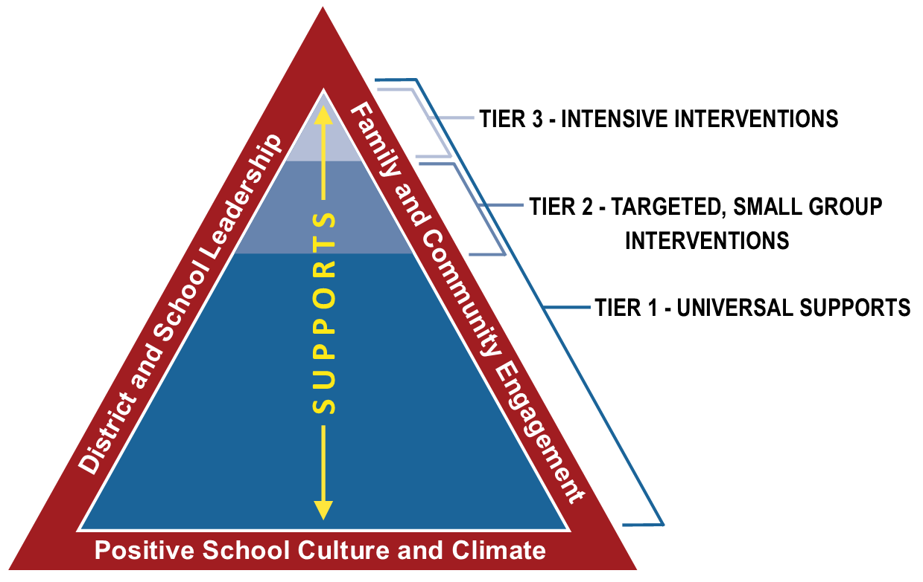
Universal Screening - NJTSS
Notes:
All of the information gained through diagnostic assessment should be used to tailor instruction and intervention for the individual student in a Tier 3 setting. When districts follow this model, a response to intervention approach is being followed.
When highly effective instructional approaches are utilized in core instruction and in targeted interventions, most mild to moderate phonological deficits can be resolved via a response to intervention approach. Students who demonstrate limited progress, despite being provided these best-practices in prevention and intervention, may require a Child Study Team Referral to determine eligibility for special education and related services.

Slide 13
Child Study Team Referral to Determine Eligibility
Review all data including universal screening, progress monitoring of the student’s response to tiered interventions, and diagnostic assessments collected to date
Gather information about birth and family history, medical history, speech and language development, and educational history
Assess in all areas of suspected disability
Notes:
A Child Study Team evaluation can identify the source of a reading problem. It should determine if a student’s profile fits the definition of dyslexia, rule out or rule in other common causes of reading difficulties, and also suggest the need for additional testing or referral to a specialist. It should also provide information about a student’s individual areas of strength and weakness.
When conducting a Child Study Team assessment, it is important to review all universal screening, progress monitoring, and diagnostic assessment data collected to date; as well as information about a student’s birth history, family history, attainment of developmental milestones including speech and language development, medical and educational history, including early education. Information regarding languages spoken in the home and home literacy experiences are also important considerations.
The student should be assessed in all areas of suspected disability, which in the case of dyslexia, includes, at a minimum, phonemic awareness skills, phonological working memory, rapid naming skills, word reading, decoding skills, reading fluency, spelling, and reading comprehension.

Slide 14
Child Study Team Members
Learning Disabilities Teacher Consultant
School Psychologist
ALL team members must have a strong base of knowledge about the neurobiology of dyslexia and all aspects of reading acquisition.
Social Worker
Speech-Language Pathologist
Notes:
It is imperative that all members of the Child Study Team have a strong base of knowledge about the neurobiology of dyslexia and all aspects of reading acquisition. Child Study Team members can include the learning disability teacher consultant, school psychologist, social worker, and/or the speech-language pathologist.

Slide 15
Learning Disabilities Teacher Consultants
Have a thorough base of knowledge pertaining to the structure of language, how students learn to read, why some students struggle to learn to read, and what effective instructional practices should be implemented to remediate students’ specific areas of weakness
Include interpretation and analysis of test results
Look for patterns in the results that identify the profile of dyslexia
Notes:
Learning Disabilities Teacher Consultants should have a thorough base of knowledge pertaining to the structure of language, how students learn to read, why some students struggle to learn to read, and what effective instructional practices should be implemented to remediate students’ specific areas of weakness. An LDTC’s evaluation should include complete analysis of subtest performance and interpretation of results that identify the student’s current levels of performance and how the student’s performance impacts his or her mastery of reading skills. An LDTC should look for patterns in test results to identify the profile of dyslexia. Typically, students with dyslexia will have difficulty with spelling and reading single words, with particular difficulty decoding nonsense or unfamiliar words. Reading comprehension is often superior to decoding individual words, and oral reading is inaccurate and labored. Evidence in the evaluation results should demonstrate a phonological and/or orthographic weakness with other higher-level language functions relatively unaffected. LDTCs can play an important role as a mentor or coach in implementing effective reading interventions.

Slide 16
Social Workers
Play an important role in supporting families’ needs and identifying key factors which impact a student’s progress
Identify genetic and family background
Investigate emotional and environmental factors
Notes:
Social Workers play an important role in supporting families’ needs and identifying key factors which impact a student’s progress. Social workers’ interviews with family members should identify genetic and familial background that can help explain underlying neurobiological challenges that result in difficulty with mastering the phonological code, as well as any emotional and environmental factors.

Slide 17
Speech-Language Pathologists
Play an important role during the evaluation process due to the connection between spoken and written language and the role both play in the development of literacy skills
Investigate both receptive and expressive language skills in the areas of phonology, morphology, syntax, semantics and pragmatics
Notes:
Speech-Language Pathologists can play an important role during the evaluation process due to the connection between spoken and written language and the role both play in the development of literacy skills. Students with a history of speech and language delays, as well as difficulty using language strategically to communicate, think and learn can impact the development of reading and writing skills. A comprehensive evaluation should include assessment in both receptive and expressive language skills that assess the areas of phonology, morphology, syntax, semantics and pragmatics.

Slide 18
School Psychologists
Understand the progression of literacy development and can identify the phase at which students are functioning
Explain how cognitive testing results relate to reading achievement
Provide sound recommendations for educational programming
Notes:
School Psychologists should understand the progression of literacy development and can identify the phase at which students are functioning. They can interpret how cognitive testing results relate to the student’s reading achievement and can provide sound recommendations for the educational programming of the student.

Slide 19
Cognitive Function
Processing speed and working memory weaknesses may be present
IQ is not the best predictor of how easily a student will develop written language skills
A specific learning disability may also be determined by utilizing a response to scientifically-based interventions methodology
A note about twice exceptional students: information on IQ and a discrepancy between ability and achievement could help in identifying these students
Notes:
Researchers have identified cognitive abilities that, when deficient, may further exacerbate difficulty in learning to read and spell. Two of these cognitive abilities are processing speed and memory span or working memory.
School Psychologists should understand that while an intelligence test was once considered to be an integral part of a dyslexia assessment, research has demonstrated that intelligence is not the best predictor of how easily a student will develop written language skills. In fact, oral language abilities, listening and speaking, are the best predictors of reading and spelling ability acquisition. Research has also proven the central role of a phonological deficit in diagnosing dyslexia. This deficit is a primary cause of dyslexia in students who, for a variety of reasons, may or may not have a discrepancy between IQ and reading skill or achievement.
In instances when a severe discrepancy is not demonstrated, the New Jersey Administrative Code states that a specific learning disability may also be determined by utilizing a response to scientifically based interventions methodology. Data collected during progress monitoring and the diagnostic assessment process can document a need for special education services due to a student’s poor response to intervention. Researcher Joe Torgesen’s review of intervention research found that with highly effective interventions, the largest gains occurred within the first 15-20 hours of instruction with continued progress after that at a dramatically lower pace, but not reaching a plateau. Districts using this methodology should identify criteria for eligibility when using this process.
Evaluators should also note, that when it comes to twice exceptional students, even though arguments against diagnosing dyslexia on the basis of a performance discrepancy have much validity, information on IQ and a discrepancy between ability and achievement is particularly important for identifying these students who are both academically talented and learning disabled.

Slide 20
Activity:
Understanding the Tools Needed to Assess for Dyslexia
Dyslexia is a specific learning disability that is neurobiological in origin. It is characterized by difficulties with accurate and/or fluent word recognition and by poor spelling and decoding abilities. These difficulties typically result from a deficit in the phonological component of language that is often unexpected in relation to other cognitive abilities and the provision of effective classroom instruction. Secondary consequences may include problems in reading comprehension and reduced reading experience that can impede the growth of vocabulary and background knowledge. (N.J.A.C. 6A: 14-1.3)
Notes:
The collaboration between teachers, administrators, and Child Study Team members is essential for early identification of dyslexia and to fostering literacy acquisition in general education settings where students are at risk for or experiencing reading and writing disorders.
The definition of dyslexia used in the NJ administrative code states that dyslexia is characterized by difficulties with accurate and/or fluent word recognition skills, poor decoding and spelling skills. It goes on to state that these difficulties are due to a deficit in the phonological component of language. Thus, a thorough evaluation for a student suspected of dyslexia will look closely at the student’s phonological awareness, real word reading, nonsense word reading, oral reading fluency, spelling skills, as well as rapid automatic naming skills which is a cognitive skill that correlates to reading fluency performance.
Interpretation and analysis of each student’s testing results is essential so that the underlying skill deficits contributing to their reading difficulties are understood and the appropriate remedial services can be identified.
As we bring this final session of the webinar series to a close, we will leave you with one last follow up activity. Hopefully these activities have been helpful as your team members translate the information discussed in the webinars into best practices in your schools and classrooms.

Slide 21
Activity:
Understanding the Tools Needed to Assess for Dyslexia
Take an inventory of the evaluation tools you have access to in your district. Ask: What do we have? What do we need?
Use the following chart to determine which evaluations target the areas needed for a thorough assessment for dyslexia.
Notes:
It is important to take an inventory of the evaluation tools you currently have access to in your district. As your stakeholder team or PLC completes this inventory, you should ask yourselves, “What tools do we currently have and what tools do we need in order to target the areas needed for a thorough assessment for dyslexia?” The goal of this activity is to identify a screening process and tools for grades K through 3 as well as tools for monitoring progress in the classroom and for Tier 2 and 3 interventions.
Next up is a chart outlining each area of focus to help your team evaluate your tools.

Slide 22
Focus of Assessment | Phonological Memory | Tool Needed
Phonological/Phonemic Awareness
Phonological Memory
Rapid Automatic Naming
Letter-Sound Identification
Word Recognition Fluency (Real Word Reading)
Word Recognition Fluency/Decoding (Nonsense Word Reading)
Encoding (Spelling)
Oral Reading Fluency
Oral Vocabulary vs. Written Vocabulary
Listening Comprehension vs. Reading Comprehension
Notes:
This chart is downloadable for your team’s use at the NJ Department of Education website.

Slide 23
Notes:
To extend your learning, please visit the special education section of the NJ Department of Education website under the heading “Dyslexia and Other Reading Disabilities” for additional webinars on dyslexia, a dyslexia resource directory, and additional resources for families, educators and community members regarding NJ standards, best practices and professional development opportunities.
You can also visit the New Jersey Tiered Systems of Support webpage to learn more about the initiative and the resources available.

Slide 24
Thank You!
Notes:
Thank you so much for joining us for this four part webinar series, “Exploring the New Jersey Dyslexia Handbook: A Guide to Early Literacy Development and Reading Struggles.” We hope that this series with its coordinated tools and activities helped your district team members become familiar with the guidance contained in the state handbook and supported them in making the best educational programming decisions for the students in their schools.

